Slide 1
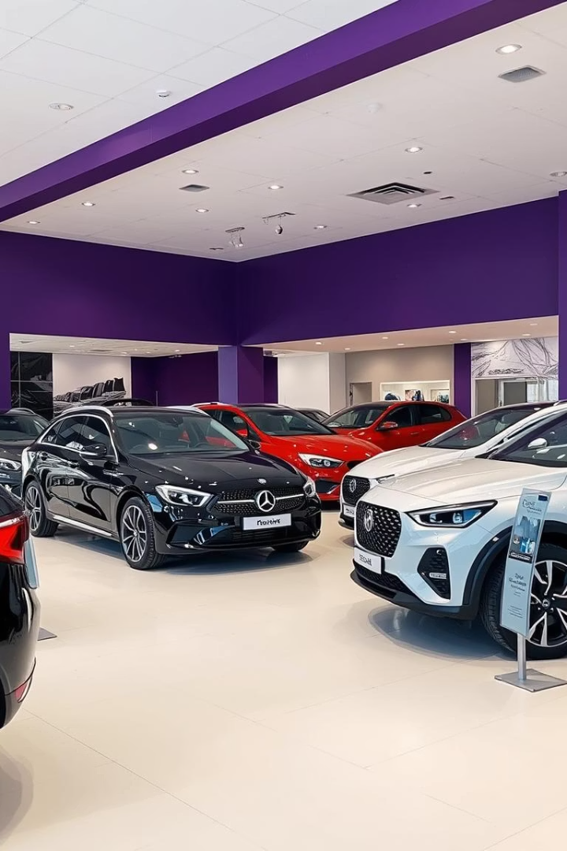
Showroom Management System Overview
This presentation introduces the Double A Wheels Showroom Management System, designed using Object-Oriented Programming principles. The system manages vehicles, customers, employees, and sales transactions efficiently. It supports various vehicle types including cars, bikes, electric vehicles, and trucks, each with specific attributes and functionalities.
The system tracks inventory, sales, and generates reports to aid showroom operations. It also provides features like vehicle search, price comparison, and low stock alerts to enhance management capabilities.

Slide 2
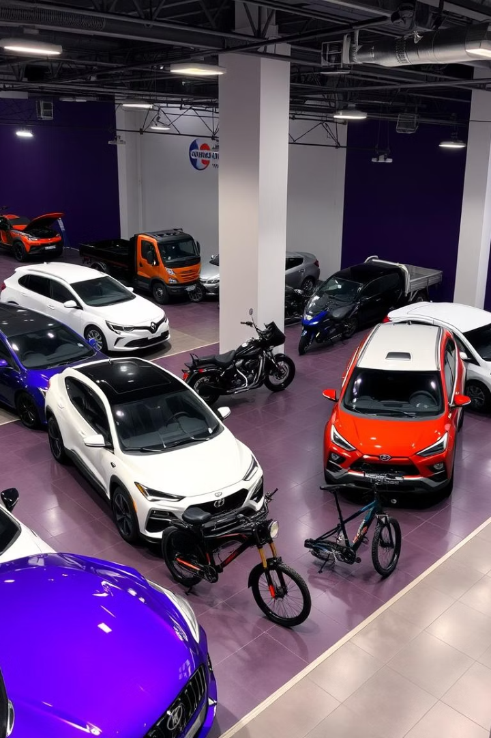
Vehicle Classes and Attributes
Base Vehicle Class
Stores common attributes like manufacturer, model, color, model year, engine capacity, price, and stock. Tracks total vehicles and total worth.
Derived Vehicle Types
Includes Car, Bike, Electric Vehicle (EV), and Truck classes, each adding specific attributes such as body type, convertible status, battery capacity, or load capacity.

Slide 3
Customer and Employee Management
Customer Class
Employee Class
Inherits from Person, tracks unique customer ID and contact details. Supports adding and displaying customers.
Also inherits from Person, includes employee ID, position, and contact info. Manages employee records and displays details.

Slide 4
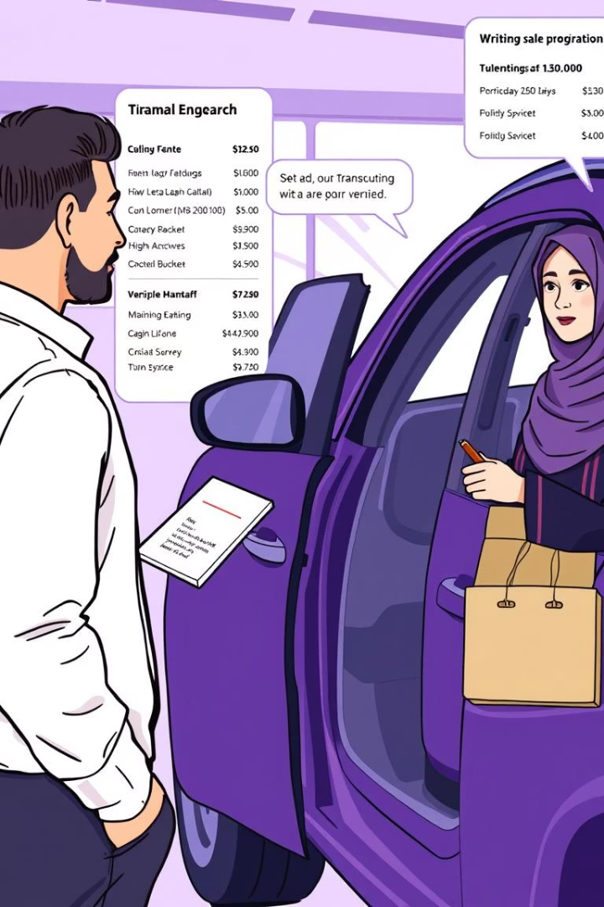
Sales and Transactions
1
Sale Creation
2
Transaction Display
Records sale details linking customer, vehicle, and employee. Updates stock and total profit.
Shows detailed sale information including vehicle specs and involved parties.
3
Price Comparisons
Compares prices between vehicles or sales to assist decision-making.

Slide 5




Showroom Operations and Features
Vehicle Search
Delete Vehicle
Low Stock Alert
Find vehicles by model quickly within inventory.
Remove vehicles from inventory and update total worth.
Notifies when vehicle stock falls below threshold to prompt restocking.

Slide 6




Inventory and Reporting
Inventory Tracking
Maintains counts of total vehicles, cars, bikes, EVs, and trucks available.
Sales Summary
Tracks total vehicles sold and total profit earned by the showroom.
Customer and Employee Counts
Monitors active customers and employees for operational insights.

Slide 7
User Interaction and Menu Options
Menu Features
Additional Functions
Add Vehicle, Customer, Employee
Low Stock Check
Display Vehicles, Customers, Employees
Generate Reports
Make Sales and View Transactions
Search and Delete Vehicles
Price Comparisons

Slide 8

Summary and Benefits
Comprehensive Management
Efficient Inventory Control
Integrates vehicle, customer, employee, and sales data for streamlined showroom operations.
Tracks stock levels and sales to optimize vehicle availability and profitability.
Enhanced Decision Making
Price comparisons and detailed reports support informed business choices.

Slide 9
Concepts Used
Encapsulation
Inheritance
Operator Overloading
Polymorphism (Runtime & Compile Time)
Friend Function & Classes
Static Members
Constructor Destructors
Association, Aggregation & Composition.
Template

Slide 10
